Slide 1




Introduction to Blockchain Technology
Course Introduction
Introduction to Blockchain Technology
SoftUni Team
Technical Trainers
Software University
http://softuni.bg

Slide 2

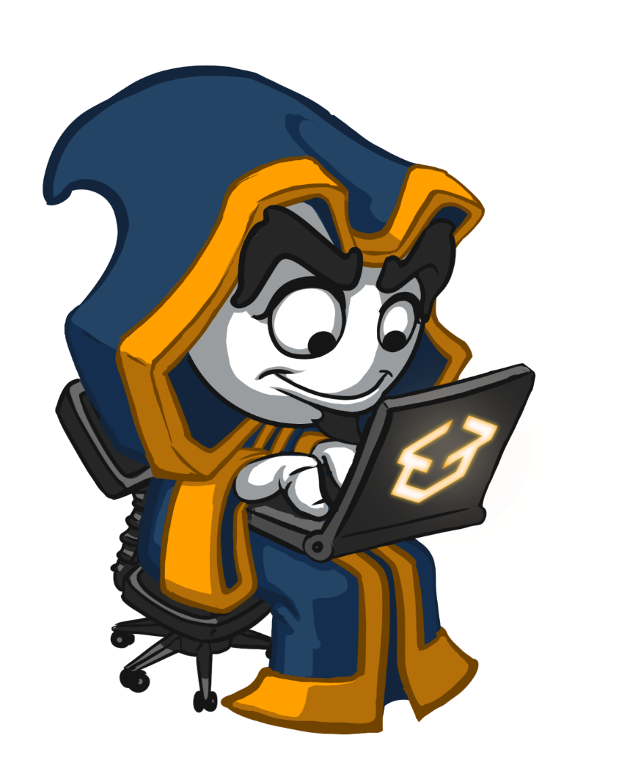

Table of Contents
Course Objectives
Course Program
Trainers Team
Course Schedule
Exams and Evaluation
Learning Resources

Slide 3
Questions
sli.do #B-Chain-Intro

Slide 4

Introduction to Blockchain Technology
Course Objectives & Program

Slide 5

Introduction to Blockchain Technology – Course Program
Introduction to Blockchain
Introduction to Cryptography
Cryptocurrencies and Decentralized Currencies
Storing and Using Coins, Wallets, Security
Mining Coins, Hardware, Infrastructure, Pools
Ethereum and Smart Contracts
Initial Coin Offerings (ICO)

Slide 6

The Trainers Team

Slide 7
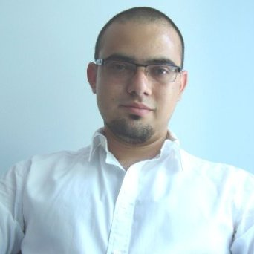
Trainers Team
Hristo Hristov
Me in 30 Seconds
8 year total experience in Business Analysis
Intrested in Blockchain since 2012
Microsoft Certified Professional
Certified Bitcoin Professional
http://chrisstov.com/

Slide 8

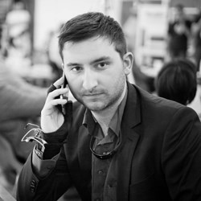

Trainers Team (2)
Vladislav Dramaliev
Martin Kuvandjiev
Radi Atanassov

Slide 9

Introduction to Blockchain Technology
Duration, Languages, Technologies

Slide 10


Training Duration – Course Name(Required)
Lessons: ~21 hours (onsite + videos)
Homeworks: ~10 hours
Exam: Final Quiz
Schedule: January – March 2018
Exam date: 18 March 2018

Slide 11



Why English?
Why the slides are in English?
English is the native language of the software engineers
Specific terminology should be in English
Translations are inaccurate and funny
Just learn English!
No excuses

Slide 12
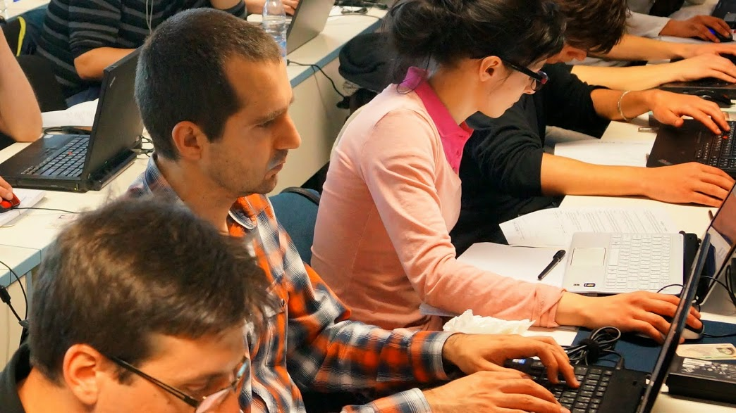


Introduction to Blockchain Technology
Evaluation Criteria

Slide 13


Scoring System
Exam – 90%
Homework – 10%

Slide 14
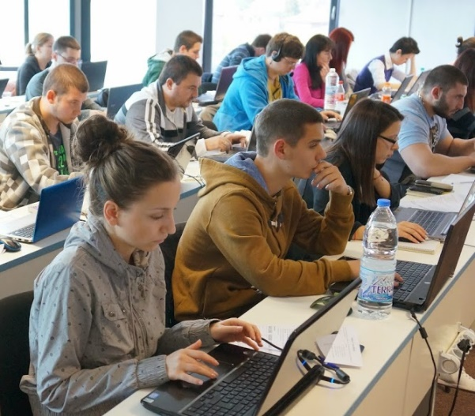

Exam
Final Quiz
40 questions with single and multiple choice answers
1 hour for solving

Slide 15

Homework Assignments
Doing your homework is very important!
Each lesson is followed by homework
Homework assignments are due in 6 days after each lecture
Submission through course’s page on our platform: softuni.bg

Slide 16










Resources
What We Need Additionally?

Slide 17



PF Course Web Site, Forum and FB Group
Official web site:
Official discussion forum:
Official Facebook groups:
softuni.bg/trainings/1868/introduction-to-blockchain-technology-january-2018
softuni.bg/forum/categories/118/vyvedenie-v-blockchain-tehnologiyata
facebook.com/groups/BlockchainTechnologyJanuary2018

Slide 18

The Course Name(Required) Slides and Videos
All lecture slides, videos, homework assignments, projects and other resources are open content, available for free
Visit the course web site to access the course resources

Slide 19
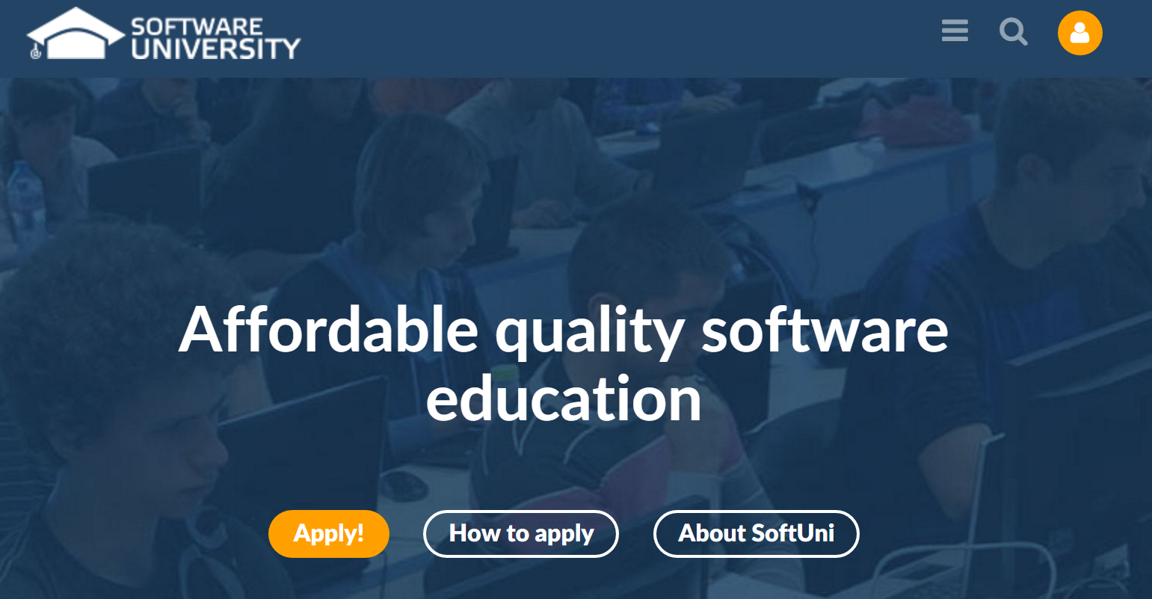
Software University Learning System (SULS)
Software University Learning System (SULS)
www.softuni.bg
Important resource for students
Homework submissions
Homework check-up
Exams and results
Reports about your progress
…

Slide 20







Introduction to Blockchain Technology – Course Overview
https://softuni.bg/opencourses/python-fundamentals-course

Slide 21
License
This course (slides, examples, demos, videos, homework, etc.) is licensed under the "Creative Commons Attribution-NonCommercial-ShareAlike 4.0 International" license

Slide 22





Trainings @ Software University (SoftUni)
Software University – High-Quality Education, Profession and Job for Software Developers
softuni.bg
Software University Foundation
http://softuni.foundation/
Software University @ Facebook
facebook.com/SoftwareUniversity
Software University Forums
forum.softuni.bg

